Slide 1
Formulation: Working out the Details
Emmanuel Letier

Slide 2
Phase 4: Formulation (a.k.a. “requirements specification”)
Initiation: Scoping the Problem
Investigation: Understanding Problems and Solutions
Decision: Scoping the Solution
Formulation: Working Out the Details
Validation: Checking the Requirements Quality
Evolution: Managing Changes
Input:
features selected for implementation
Output:
Detailed, testable requirements for the features
Who:
“the 3 amigos”: business representative, developers, testers + other persons with interest or expertise in the feature

Slide 3
Phase 4: Formulation (a.k.a. “requirements specification”)
When:
Just-in-time: in small increments, just before and during coding
faster, incremental delivery of features
Upfront: multiple features defined and analysed together before coding
enables reasoning about global properties and feature interactions before spending time on coding
Techniques:
Specification by example
Requirements patterns
Goal-oriented requirements specification
Formal specifications

Slide 4
Specification by Example
Collaborative approach where features’ desired behaviours are defined as rules (requirements) and scenarios (examples).
Scenarios act as automated acceptance tests.
Behaviour Driven Development (BDD) = agile, test-driven approach to software development that uses specification by example.

Slide 5
Concepts: Goals, Features, Requirements, Examples
Goal
A desired property of the World
contributes to
Feature
An externally visible functionality or quality that
contributes to one or more goals
is defined by a set of requirements
defines
Requirement
(aka rule in BDD)
A desired property of the feature
illustrates
Example (aka scenario)
A concrete illustration of a requirement/rule
to clarify and help understanding the rule
to serve as acceptance test

Slide 6
Example 1: Airplane braking safety feature (part 1)
Feature: Ground Spoilers Safety Feature
Goals:
Avoid [Ground Spoilers Deployed When Flying]
Maintain[Ground Spoilers Enabled After TouchDown]
Requirement:
Ground spoilers shall be enabled if and only if at least one of the following two conditions are met:
the oleo struts are compressed at both main landing gears, or
wheel speed is above 72 kts at both main landing gears.
Examples
... (next slide)
Notes:
For this requirement, we need 2^4 = 16 examples to illustrate all possible cases. When illustrating a requirement, we do not need to show all possible illustrative example. Often, it is not possible to show all possible example because the number of examples is infinite.

Slide 7
Example 1: Airplane braking safety feature (part 2)
Feature: Ground Spoilers Safety Feature
Requirement:
Ground spoilers shall be enabled if and only if at least one of the following two conditions are met:
the oleo struts are compressed at both main landing gears, or
wheel speed is above 72 kts at both main landing gears.
Examples
Left struts Compressed | Left speed above 72kts | Right struts Compressed | Right speed above 72kts | Ground Spoilers
No | No | No | No | Not enabled
Yes | Yes | No | No | Not enabled
Yes | No | Yes | No | enabled
No | Yes | No | Yes | enabled
Yes | Yes | Yes | Yes | enabled
Notes:
For this requirement, we need 2^4 = 16 examples to illustrate all possible cases. When illustrating a requirement, we do not need to show all possible illustrative example. Often, it is not possible to show all possible example because the number of examples is infinite.

Slide 8
Example 2: Ambulance Dispatching System
Feature: Duplicate calls management
Contributes to goals:
Avoid[Duplication mobilizations]
Achieve[Faster and better handling of call backs and duplicate calls]
Defined by requirements:
The system shall identify duplicate calls and support calls handlers dealing with such calls.
Example
Scenario: Notify call handler of a duplicate call
Given the CAD has information about an unresolved incident at 10 Downing Street
When the call handler receives a call about an incident at 10 Downing street
Then the call handler is presented with previous information about the incident
We will later define better requirements and scenarios for this feature.

Slide 9
Examples have 3 parts
equivalent to Arrange-Act-Assert structure of unit tests
Context
The state of the machine at the beginning of the example
(aka. Precondition, Arrange)
Action
An event that triggers the behaviour being illustrated. (sometimes the event is implicit)
Outcome
The desired state of the machine after the action has happened
(aka. Postcondition, Assert)

Slide 10
Example 1: Airplane braking safety feature
Context
Left struts compressed: Yes
Left speed above 72kts: Yes
Right struts compressed: No
Right struts above 72kts: No
Action
An implicit state transition (a compute cycle)
Outcome
Ground spoilers state: Not enabled

Slide 11
Example 2: Notify call handler of duplicate call
Context
Given the CAD has information about an unresolved incident at 10 Downing Street
Action
When the call handler receives a call about an incident at 10 Downing street
Outcome
Then the call handler is presented with previous information about the incident

Slide 12
Many formats
Examples can be documented in many forms:
Free text, tables of input-output pairs, sequences of steps, UI sketches and wireframes
Some forms can be linked to automated acceptance tests
FIT tables: FitNesse acceptance testing framework
Gherkin scenarios (Given-When-Then): Cucumber, Specflow, Jbehave, Serenity BDD, etc.
Notes:
Reference:
Gojko Adzic, “Specification by Example, 10 years later”, 2020
https://gojko.net/2020/03/17/sbe-10-years.html

Slide 13
Feature scenario vs domain scenario
Feature scenario
illustrates
Requirement
(aka rule in BDD)
A feature scenario = an example that illustrates a machine requirement.
defined in terms of shared and machine phenomena
three components: Context-Action-Outcome
illustrates
Domain scenario
Goal
A domain scenario = a sequence of world events that illustrates the satisfaction or violation of a stakeholder goal.
defined in terms of world phenomena, not necessarily shared with the machine
Synonym: journey scenario (Nagy & Rose, BDD books)

Slide 14
When to write feature scenarios and domain scenarios?
Feature scenarios
To discover the feature’s desired behaviour
To clarify the meaning of the feature requirements
To define acceptance tests for the feature behaviour
Goal scenarios
To illustrate how multiple agents interact and multiple features fit together to satisfy some goal.
Projects using specification by example create much fewer goal scenarios than feature scenarios.

Slide 15
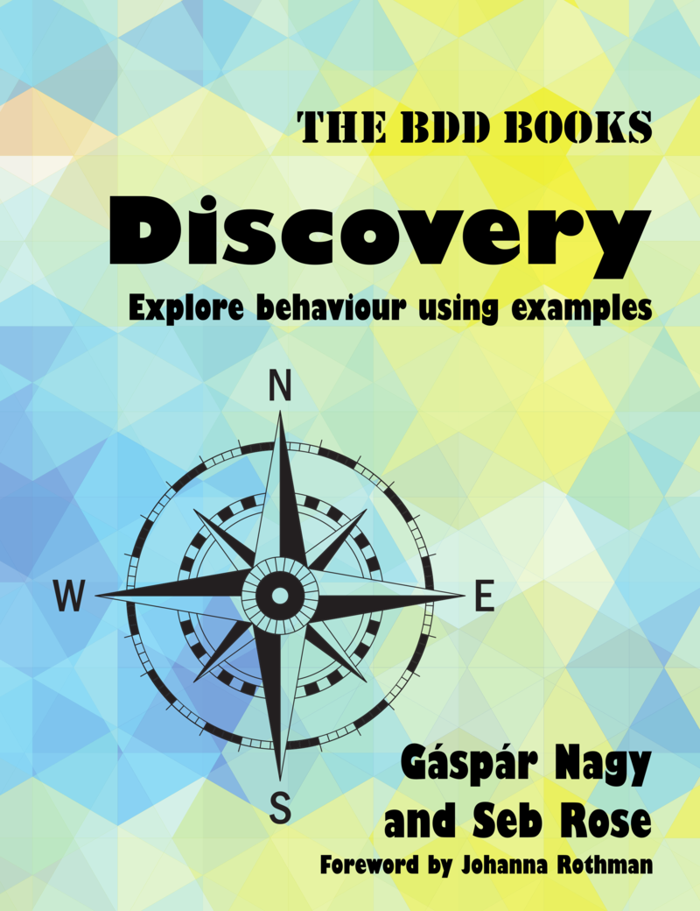
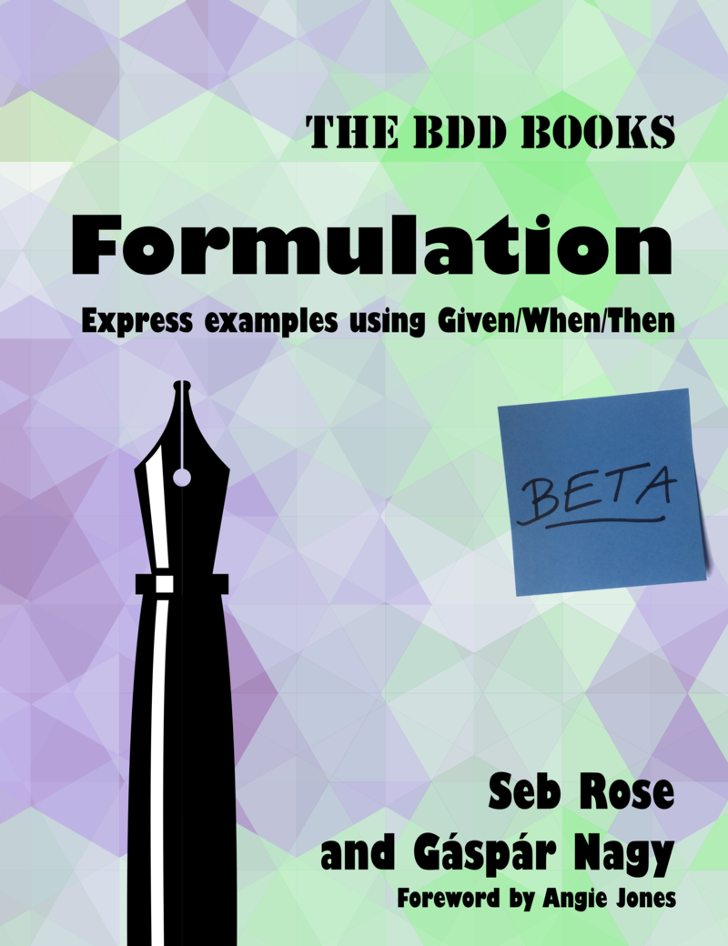
Three steps of specification by example
1. Discovery
Short meetings (<30 minutes) to identify rules and examples for a feature or user story
Technique: example mapping
2. Formulation
Formulate the examples in a structured language (Given-When-Then)
3. Automation
Write “step definitions” to transform the examples into executable test code
bddbooks.com

Slide 16
Example Mapping: discovering rules and examples

Slide 17
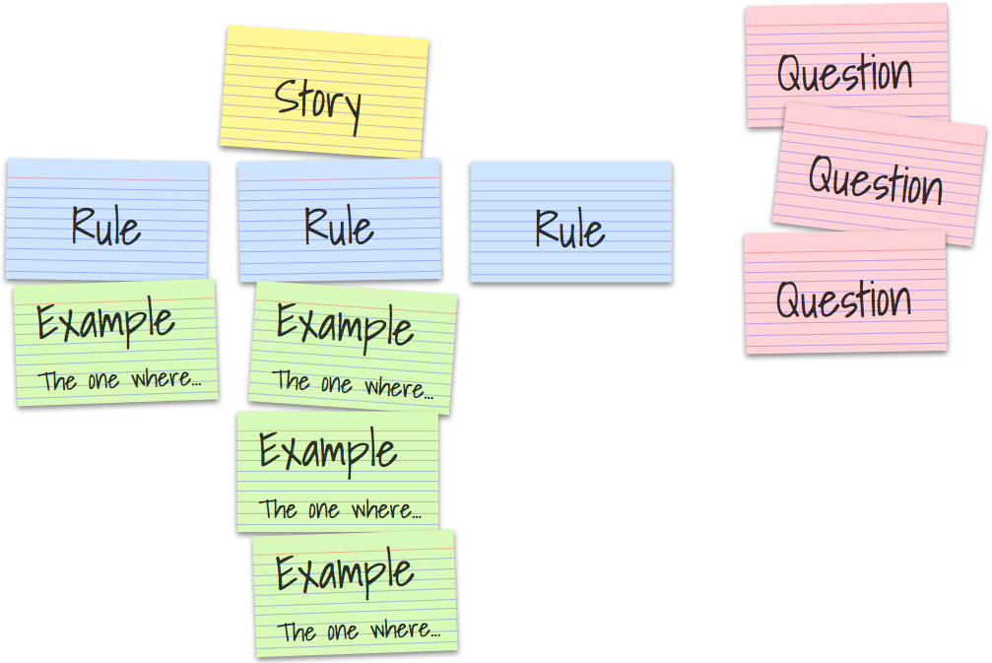
Example Mapping: Concepts
Matt Wynne, Introducing Example Mapping, 2015
https://cucumber.io/blog/bdd/example-mapping-introduction/
Any question and assumption that cannot be answered during the meeting
Figure: Matt Wynne, Introducing Example Mapping, 2015.
Notes:
Sometimes, a rule is identified first, then illustrated with one or more example.
Sometimes, the example comes first, and the rule is discovered from the examples.
Color coded cards are problematic for color blind.
More Resources
40 Minute Webinar: https://cucumber.io/blog/bdd/your-first-example-mapping-session/
https://cucumber.io/blog/bdd/example-mapping-webinar/
Example: Train Seat Booking Feature
https://github.com/emilybache/KataTrainReservation

Slide 18
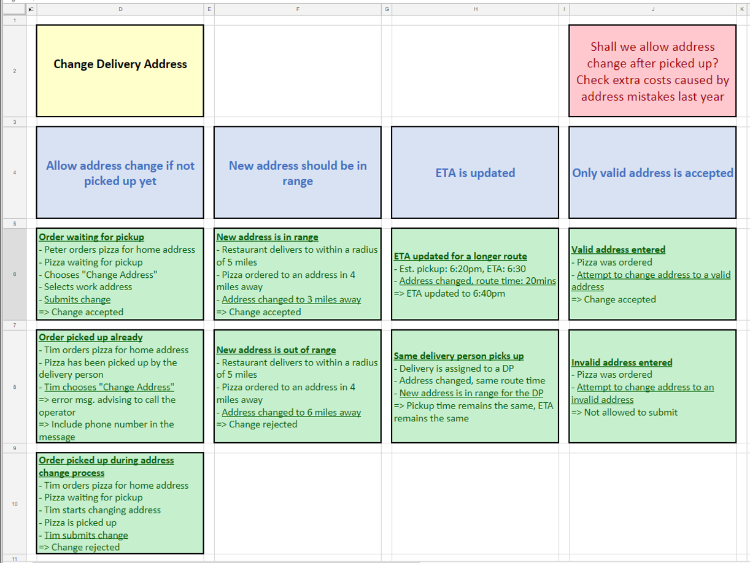
Example Mapping using spreadsheets
Figure: the BDD Discovery book - http://www.bddbooks.com/html/discovery-figures.html
Notes:
http://www.bddbooks.com/html/discovery-figures.html

Slide 19
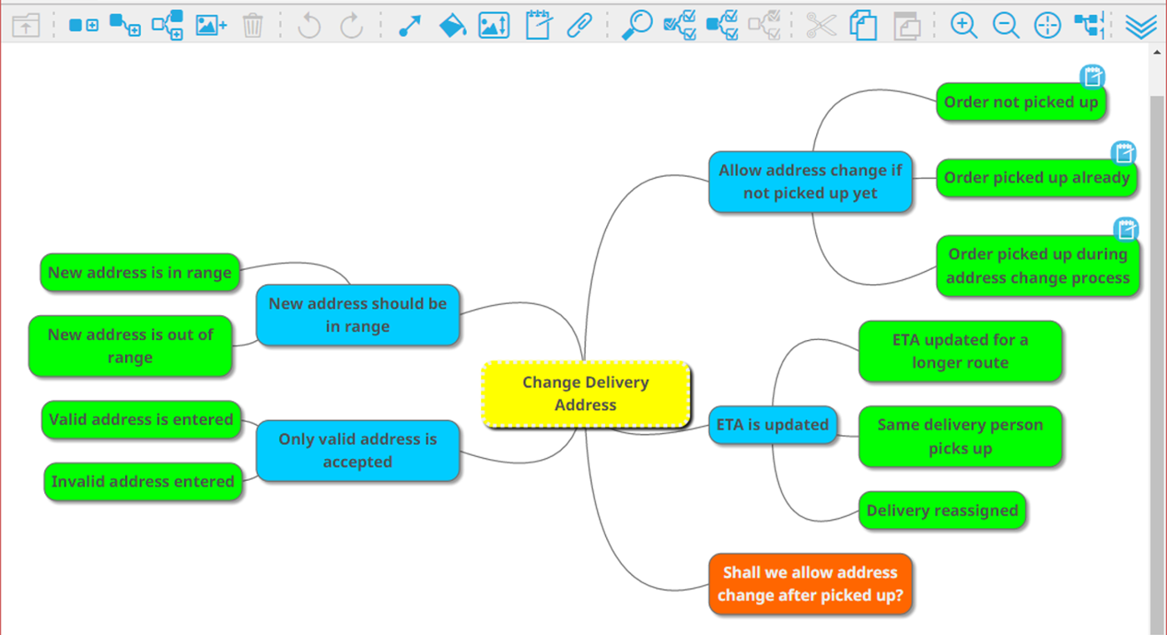
Example Mapping using mind maps
Figure: the BDD Discovery book - http://www.bddbooks.com/html/discovery-figures.html
Notes:
http://www.bddbooks.com/html/discovery-figures.html

Slide 20
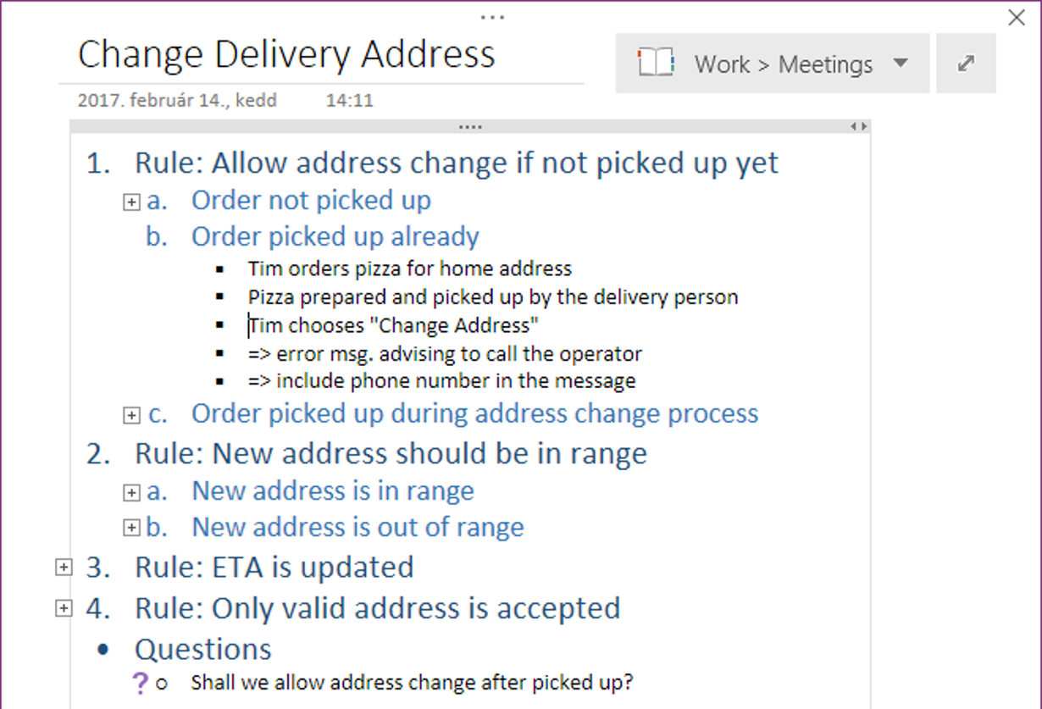
Example mapping using hierarchical notes
Figure: the BDD Discovery book - http://www.bddbooks.com/html/discovery-figures.html

Slide 21
Example: Managing duplicate calls
Mange duplicate calls
Notify call handler if reported location close to ongoing incident
No ongoing incident nearby => Do not notify
One ongoing incident nearby => Notify call handler
What if CAD has multiple ongoing incidents nearby?
When is an incident no longer “ongoing”?
How do we deal with concurrent duplicate calls?
Notes:
When is an incident no longer “ongoing”?
When ambulance arrives at the scene
When ambulance leaves the scene
When patient is discharged (at scene, at home or to hospital)?
Up to X hour after patient is discharged?

Slide 22
The same example map in textual form
Feature: Duplicate Call Management
Rules:
Notify call handler if reported location close to ongoing incident
Scenario: No ongoing incident nearby => Do not notify
Scenario: One ongoing incident nearby => Notify call handler
Question: what if multiple ongoing incidents nearby => notify call handler of all incidents?
Question: when is an incident no longer “ongoing”?
When ambulance arrives? Leaves? When patient discharged? …
Question: how do we deal with concurrent duplicate calls?

Slide 23
Guideline: Derive rules from goals
Feature: Duplicate Call Management
Goals:
avoid multiple mobilisations
faster call handling
reassure caller
reduce number of call backs
Rules:
Notify call handler if reported location close to ongoing incident
The rule contribute to the first two goals only.
We have not defined any rule to support the other 2 goals.

Slide 24


Adding new rules to support the goals
Feature: Duplicate Call Management
Goals:
avoid multiple mobilisations
faster call handling
reassure caller
reduce number of call backs
Rules:
Notify call handler if reported location close to ongoing incident
If ambulance on its way, give ETA
Scenario: ambulance on its way, and duplicate call => Give ETA and ask caller to call back only if condition changes
If ambulance at scene, ask for confirmation
Scenario: CAD believes ambulance at scene, and duplicate call => Ask caller to confirm whether ambulance at scene. If not, contact ambulance.

Slide 25
Example: Managing duplicate calls
Mange duplicate calls
Notify call handler if reported location close to ongoing incident
If ambulance on its way, give ETA
If ambulance at scene, ask for confirmation
No ongoing incident nearby => Do not notify
Ambulance on this way
=> Give ETA and ask caller not to call back unless condition changes
CAD believes ambulance at incident scene
=> Ask confirmation
One ongoing incident nearby => Notify call handler
What if CAD has multiple ongoing incidents nearby?
When is an incident no longer “ongoing”?
How do we deal with concurrent first calls?
Notes:
When is an incident no longer “ongoing”?
When ambulance arrives at the scene
When ambulance leaves the scene
When patient is discharged (at scene, at home or to hospital)?
Up to X hour after patient is discharged?

Slide 26
Observations
Our first design was simpler but less useful to call handlers
Scenario: Notify call handler of a duplicate call
Given the CAD has information about an unresolved incident at 10 Downing Street
When the call handler receives a call about an incident at 10 Downing street
Then the call handler is presented with previous information about the incident
Understanding the goals helps designing a better feature
If the example map becomes too large, the feature and user stories need to be broken into smaller pieces
e.g. Duplicate call Identification – Assessment – Resolution
Good problem decomposition is not easy, and not always given by the business.
Notes:
First design was less useful because it reports all information about the incident to the call handlers but does not guide the call handler in answering the call.
Then the call handler is presented with previous information about the incident

Slide 27
Formulating Scenarios in Gherkin (Given-When-Then Scenarios)

Slide 28
Gherkin Concepts
Each feature is described in a text file
called the feature file.
code that automates the execution of the step

Slide 29
Example of a Gherkin Scenario
Feature: Duplicate Call Identification
Rule: The CAD shall notify call handler of duplicate calls
Scenario: Reception of a duplicate call
Given the CAD has information about an unresolved incident at 10 Downing Street
When the call handler receives a call about an incident at 10 Downing street
Then the call handler is presented with previous information about the incident
This scenario has 3 steps.

Slide 30
Step Definitions
public class StepDefinitions {
@Given("the CAD has information about an unresolved incident at {string}")
public void cadHasInformationAboutIncident(String location) {
// code that creates a record of an incident at the given location in the CAD.
}
@When("the call handler receives a call about an incident at {string}")
public void callHandlerReceivesCall(String location) {
// code that simulates the call handler receiving a call related to the specified
}
@Then("the call handler is presented with previous information about the incident")
public void callHandlerPresentedwithInformation() {
// code that checks that the information about the incident is presented to the call handler.
}
}
Notes:
In practice, we also write automation code to make the step definition easier to write and maintain.
The step definitions use the automation code to interact with the system.
The automation code provides a façade to the system’s API and GUI.

Slide 31




BDD Testing Frameworks
Common BDD frameworks:
Cucumber (Java, JS, Ruby)
Behave (Python)
Specflow (C#)
Feature files
(scenarios)
BDD Testing Framework
Step definitions
Test results
Source code
Living documentation: feature files are kept up to date with the code

Slide 32
Behaviour-Driven Development Cycle

Slide 33
A Quick Tour of the Gherkin Language

Slide 34
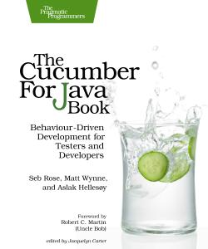
Based on
Available online through the reading list.

Slide 35
Example
Initial requirement statement
“Customers should be prevented from entering invalid credit card details.”
Feature: Feedback when entering invalid credit card details
In user testing we've seen a lot of people who made mistakes entering their credit card. We need to be as helpful as possible here to avoid losing customers at this crucial stage of the transaction.
Scenario: Credit card number too short
…
Scenario: Expiry date must not be in the past
…
Example From: Seb Rose, Matt Wynne, Aslak Hellesøy. “The Cucumber for Java Book”, 2015

Slide 36
Gherkin: Given-When-Then + And
Scenario: Credit card number too short
Given I have chosen some items to buy
And I am about to enter my credit card details
When I enter a card number that's only 15 digits long
And all the other card details are correct
And I submit the form
Then the form should be redisplayed
And I should see a message advising me of the correct number of digits (16)
Gets the system in a particular state (precondition)
Specifies a triggering event and conditions
Specifies what must be true after the triggering event occurs (postcondition)
Note: The automated acceptance tool makes not difference between keywords Given-When-Then-And; they all introduce a step.
Notes:
Ambulance example
Rule: The CAD should notify the call handler if the reported location is close to an ongoing incident
Scenario: there is an ongoing incident at the same location
Given the CAD knows about an ongoing incident at 10 Downing Street
When the call handler is answering a call
And the call is about an incident at 10 Downing street
Then the CAD notifies the call handler of the ongoing incident

Slide 37
Gherkin: Background
Feature: Feedback when entering invalid credit card details
Background:
Given I have chosen some items to buy
And I am about to enter my credit card details
Scenario: Credit card number too short
When I enter a card number that's only 15 digits long
And all the other details are correct
And I submit the form
Then the form should be redisplayed
And I should see a message advising me of the correct number of digits
Scenario: Expiry date must not be in the past
When I enter a card expiry date that's in the past
…
Use Background to factor out steps common to all scenarios in a feature.
Downsides: can decrease readability and maintainability
Notes:
equivalent to @before in unit testing frameworks
Can decrease readability because the reader must remember the background when readings each scenarios, including at the end of the feature file.
Can decrease maintainability because the maintainer must be aware of the background when adding scenarios or when moving scenarios to another feature file.
Ambulance example (not a great example)
Background the CAD knows about an ongoing incident at 10 Downing Street
Scenario: there is an ongoing incident at a nearby location
When the call handler is answering a call
And the call is about an incident at 11 Downing street
Then the CAD notifies the call handler of the ongoing incident

Slide 38
Gherkin: Background (continued example)
Background:
Given I have chosen some items to buy
And I am about to enter my credit card details
Scenario: Credit card number too short
…
Scenario: Expiry date must not be in the past
When I enter a card expiry date that's in the past
And all the other details are correct
And I submit the form
Then the form should be redisplayed
And I should see a message telling me the expiry date may not be in the past
Note: Each scenario is self-contained; it can be read and executed independently of other scenarios.
Notes:
Ambulance example
Scenario: there is an ongoing incident at a nearby location
Given the CAD knows about an ongoing incident at 10 Downing Street
When the call handler is answering a call
And the call is about an incident at 11 Downing street
Then the CAD notifies the call handler of the ongoing incident

Slide 39
Gherkin: Data Tables
Use data tables to improve readability
Given a User "Michael Jackson” born on August 29, 1958
And a User "Elvis” born on January 8, 1935
And a User "John Lennon” born on October 9, 1940
Given the following users:
| name | date of birth |
| "Michael Jackson” | August 29, 1958 |
|"Elvis” | January 8, 1935 |
| "John Lennon” | October 9, 1940 |
Note: BDD frameworks convert data table string to a DataTable object that can be used in step definitions.
Notes:
Note: Cucumber and other BDD framework parse strings representing data tables and conver them to a DataTable object that can be used in step definitions.
Ambulance example:
Given an incident at 10 Downing Street reported today at 10:00, with status "resolved"
And an incident at 11 Downing Street reported today at 10:05, with status "ambulance mobilized"
And an incident at Westminster Tube Station reported today at 10:09, with status "waiting for allocation"
-> Given the CAD has the following incidents
| location | reported time | status|

Slide 40
Gherkin: More Use of Data Tables
A table with row headings
A list
Then I should see a vehicle that matches the following description:
| Wheels | 2 |
| Max Speed | 60 mph |
| Accessories | lights, shopping basket |
Then my shopping list should contain:
| Onions |
| Potatoes |
| Kale |
| Apples |
| Relish |

Slide 41
Gherkin: Scenario Outlines
Used to defined sets of scenarios with same patterns but different argument and outcome values. Angle brackets <..> indicate placeholders.
Scenario Outline: Withdraw fixed amount
Given I have <Balance> in my account
When I choose to withdraw the fixed amount of <Withdrawal>
Then I should receive <Received> cash
And the balance of my account should be <Remaining>
Examples:
| Balance | Withdrawal | Received | Remaining |
| $500 | $50 | $50 | $450 |
| $500 | $100 | $100 | $400 |
| $500 | $200 | $200 | $300 |
Notes:
Placeholders indicated with angle brackets <..>

Slide 42
Gherkin: Rules
Used to structure scenario and present the rules they illustrate.
Rules are not processed by the BDD testing framework.
Rule: A user cannot withdraw more than their account’s balance.
Scenario: User attempts to withdraw more than the balance
Given a user has £10 in their account
When they choose to withdraw £20 from their account
Then they will be told they cannot withdraw more than the account’s balance.
Notes:
Rules are ignored by the BDD testing framework.
Each rule is followed by a set of scenario that illustrate the r
Rule: some rule
Scenario ..
Scenario …
Rule: …
Scenario …

Slide 43
Localisation
Gherkin Keywords have been translated to over 70 languages
English Keywords | Chinese simplified
feature | 功能
rule | Rule 规则
scenario | 场景 剧本
given | 假如 假设 假定
when | 当
then | 那么
Check other languages https://cucumber.io/docs/gherkin/languages/
Contribute to the Github repository if missing or incorrect

Slide 44
Scenario Writing Guidelines

Slide 45
Understand the role of each parts
Context
The ”Given” part describe a state of the machine at the start of the scenario.
Action
The “When” part describes an action, initiated by the World or the Machine.
Outcome
The “Then” part describes the desired state of the machine after the action.

Slide 46
Writing Style: Given steps (context, precondition)
A Given step describes the state of the machine.
Write a “Given” step as:
a declarative sentence with stative verb in past or present tense.
Given the CAD holds information about an unresolved incident at 10 Downing Street
Given the user is logged in
Given the user made two failed logging attempts
a noun phrase
Given an incident at 10 Downing Street
Given a user named “Dave”
Given a user with an empty shopping basket

Slide 47
Writing Style: When steps (action)
A When step describes a shared action, initiated by the World or the Machine.
Write a When step as
a declarative sentence with an action verb in the present tense.
When the call handler receives a call about an incident at 10 Downing Street
When the CAD searches for the nearest available ambulances
Note: The When step describes the action to be tested by the scenario.

Slide 48
Writing Style: Then steps (outcome, postcondition)
The Then steps describe the desired state of the machine after the action.
Use a declarative sentence with:
a modal verb expressing obligation (“should”, “shall”, “will”, “must”)
Then the form should be redisplayed
And I should see a message advising me of the correct number of digits (16)
a stative verb in the present tense.
Then the call handler is presented with previous information about the incident

Slide 49
Keep the objectives in mind
The main purpose is communication and keeping stakeholders engaged.
The scenarios should clarify the requirements, they are not meant to be exhaustive tests.
The scenarios should support the evolution of the product by being resilient to change and easy to maintain.

Slide 50
Six principles: BRIEF
Business Language
written in the language of the business (the World)
Real data
using concrete, real data
Intention revealing
every line should describe intent, not mechanics
Essential
illustrates a rule without incidental information
Focused
illustrates a single rule
Brief
should be short

Slide 51
Common Mistakes

Slide 52
Mistake #1: Scenario is a rule, not a concrete example
Feature: Charge Users for Bike Hires
Rule: The first 30 minutes of each journey is free; longer journeys have an additional fee of £2 for each extra 30 minutes started.
Scenario: a journey less than 30 min
Given the journey is less than 30 minutes
Then the journey is free
Scenario: a journey between 30 min and an hour
Given the journey is between 30 min and an hour
Then the journey cost £2
The scenarios restate the rule; they don’t illustrate it.
No When step. What is the action being defined and tested?
No concrete data. What concrete data are needed to code the action?
Students’ scenarios in past exercises

Slide 53
Fix: Clarify the action and use concrete data
Rule: The first 30 minutes of each journey is free; longer journeys have an additional fee of £2 for each extra 30 minutes started.
Scenario outline: a journey cost is computed
Given a user hires a bike at <start time>
And returns the bike at <return time>
When the journey cost is calculated
Then the journey's duration is <duration>
And the journey will be charged <cost>
Examples: | start time | return time | duration | cost |
| 10:05 | 10:35 | 30 | 0 |
| 10:45 | 11:16 | 31 | 2 |
| 11:11 | 12:11 | 60 | 2 |
| 12:30 | 13:35 | 65 | 4 |
The Given part describes the state and arguments relevant to the action.
The Then part describes the action’s return values and resulting state.
Note: data must be relevant to the scenario.
E.g. we don’t include the journey’s start and return locations, user’s name, etc.

Slide 54
Mistake #2: Describing the mechanics of interactions ( a “clickety-click” scenario”)
Scenario: Dave logs in before reading an article
Given a User ”Dave” exists with password "secret”
And I am on the home page
And I am not logged in
When I click on the link for the page “How to write better scenarios”
Then I am redirected to the login form
When I fill in "Username” with ”Dave”
And I fill in "Password” with "secret”
And I click "Login”
Then I should be on the page “How to write better scenarios”
Long and boring to read.
The scenario is not robust to changes in user interface.
The purpose (intention) of the scenario is not clear.
Multiple When steps suggest more than one intention.
Example adapted from: Seb Rose, Matt Wynne, Aslak Hellesøy. “The Cucumber for Java Book”, 2015

Slide 55
Fix: Reveal intentions using the domain language
Rule: Unauthenticated visitors must login before seeing restricted pages.
Scenario: An unauthenticated visitor attempts to read a restricted page
Given a visitor who is not authenticated
When the visitor attempts to view some restricted page
Then the system redirects to visitor to a login form
Scenario: A visitor is redirected to the right page after logging in
Given a visitor who is not authenticated
And the visitor attempted to view some restricted page
And the system redirected to visitor to a login form
When the visitor authenticates with valid credentials
Then the system should show the restricted page
The rule and scenarios names reveal the intention
The fix reveal important domain concepts (unauthenticated users, restricted page, credentials)
The scenario is more robust to changes

Slide 56
Mistake #3: Include incidental details
(Incidental = not relevant to the scenario’s purpose)
Scenario: Check inbox
Given a user "Dave” with password "password”
And a user "Sue” with password "secret”
And an email to "Dave” from "Sue”
When I sign in as “Dave” with password “password”
Then I should see 1 email from “Sue” in my inbox
Are the passwords relevant to this scenario?
What is the scenario’s purpose? What rule is it meant to illustrate?
Notes:
Example from The Cucumber for Java Book

Slide 57
Fix: Remove unnecessary steps and details
(Incidental = not relevant to the scenario’s purpose)
Feature: Check Inbox
Rule: Show inbox content after signing in
Scenario: a user sees their inbox after signing in
Given Dave’s inbox contains one email from Sue
When Dave signs in
Then Dave sees that their inbox contains the email from “Sue”
Does it matter that the email is from Sue?
Does it matter that the user is Dave?
Shouldn’t the scenario also talk about the email subject line, content, date and time?
Notes:
Adapted from examples from The Cucumber for Java Book
Does it matter that the email is from Sue?
No. What matters is that the email in the Then step is the same as the email in the Given step.
Does it matter that the user is Dave?
No. What matters is that the user sees the content of their own inbox, not someone else’s.
We could thus simplify this scenario as follows.
Scenario: a user sees their inbox after signing in
Given a user’s inbox contains one email
When the user signs in
Then the user sees that their inbox contains the email

Slide 58
Compare two scenarios: which do you prefer?
Scenario: a user sees their inbox after signing in
Given a user’s inbox with one email
When the user signs in
Then the user should see their inbox contains one email
Scenario: a user sees their inbox after signing in
Given Dave’s inbox contains one email
|From | Subject | Date |
| Sue | Hello! | 1 Nov 2023, 17:00 |
When Dave signs in
Then Dave should see their inbox contains 1 message
And Dave’s inbox should show
|From | Subject | Date |
| Sure | Hello! | 1 Nov 2023, 17:00 |
Deciding what is essential and what is incidental is relative to the scenario’s purpose.

Slide 59
Mistake #4: Writing a scenario with multiple purposes
Scenario: Withdraw fixed amount of $50
Given I have $500 in my account
And I have pushed my card into the slot
And I enter my PIN
And I press "OK”
When I choose to withdraw the fixed amount of $50
Then I should receive $50 cash
And the balance of my account should be $450
This scenarios describes two things: authentication and cash withdrawal
Authentication steps are incident details that distract from the scenario main purpose which is to describe cash withdrawal
Example From: Seb Rose, Matt Wynne, Aslak Hellesøy. “The Cucumber for Java Book”, 2015

Slide 60
Fix: Write multiple single-purpose scenarios
Feature Authentication
Scenario: Successful login with PIN
Given I have pushed my card in the slot
When I enter my PIN
And I press "OK”
Then I should see the main menu
Feature Cash Withdrawal
Background:
Given I have authenticated my card
Scenario: Withdraw fixed amount of $50
Given I have $500 in my account
When I choose to withdraw the fixed amount of $50
Then I should receive $50 cash
And the balance of my account should be $450
Note the authentication steps in the two scenarios are at different levels of abstraction.

Slide 61
Caution: Don’t use “I” in scenarios
Because of ambiguity: if reader identifies with “I”, the meaning changes based on who is reading the scenario
Scenario: Check inbox
Given I have received an email from "Sue”
When I sign in
Then I should see 1 email from "Sue” in my inbox
Guideline from: Seb Rose, Gaspar Nagy. “The BDD Books - Formulation”, 2020
Example From: Seb Rose, Matt Wynne, Aslak Hellesøy. “The Cucumber for Java Book”, 2015

Slide 62
Fix: write scenario in the third person
and identify actors by role or persona
Scenario: Check inbox
Given “Dave” received an email from "Sue”
When “Dave” signs in
Then “Dave” should see 1 email from "Sue” in his inbox
Scenario: Check inbox
Given a user’s inbox has one email
When the user signs in
Then the user should see their inbox content with the single email

Slide 63
Mistake #5: Using meaningless data
Scenario: Check inbox
Given User1 received an email from User2
And the email has the subject line “subject line”
When User1 signs in
Then User1 should see 1 email from User2 with the subject line “subject line”
This makes the scenario artificial and hard to read
Fix: Use real or realistic data

Slide 64

Given-When-Then with Style - The Challenges
Short exercises and discussions about writing useful scenarios.
https://specflow.org/blog/the-given-when-then-with-style-challenge/
Notes:
Different styles are useful in different context, and it is possible to spend too much time on improving scenarios (“The best is the enemy of the good”).
Start with the “Writing Style” Category

